Slide 1
Molecular-directed cancer treatments: Precision Medicine Molecular Tumor Board
Mark E. Burkard MD PhD

Slide 2
Here’s my DNA sequence

Slide 3
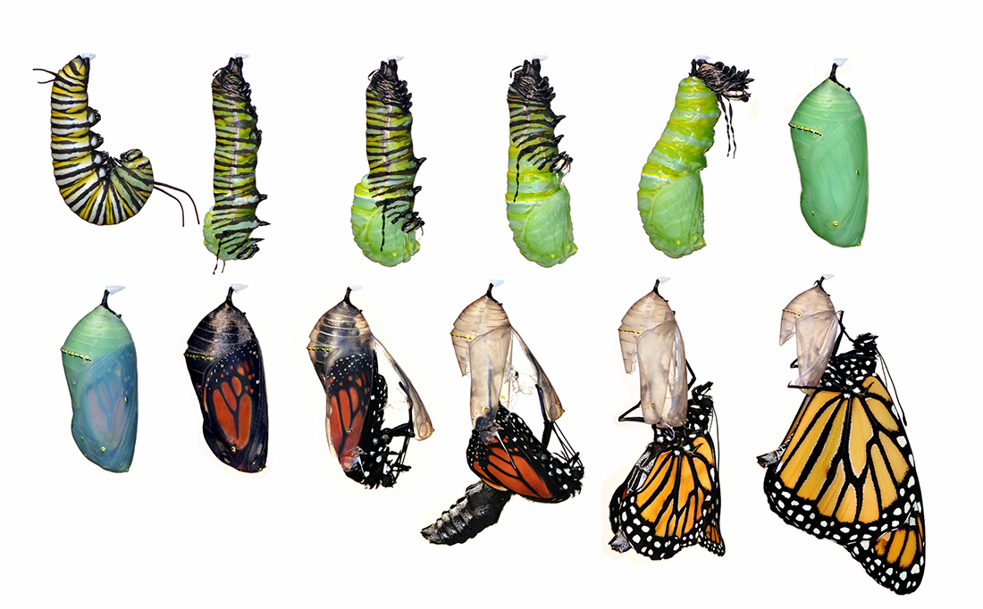
Embrace change

Slide 4
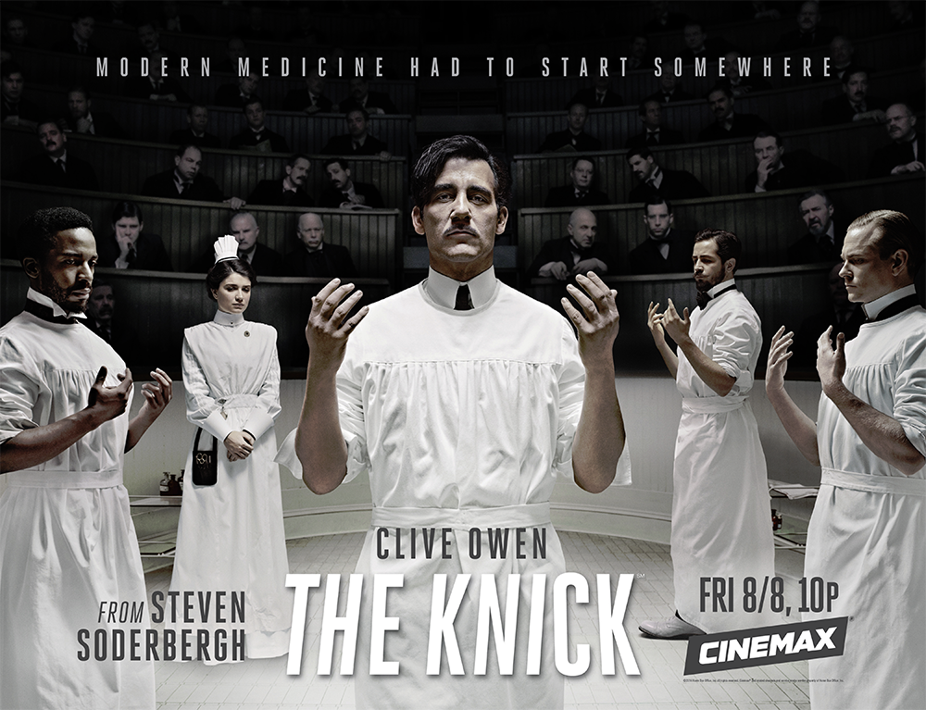
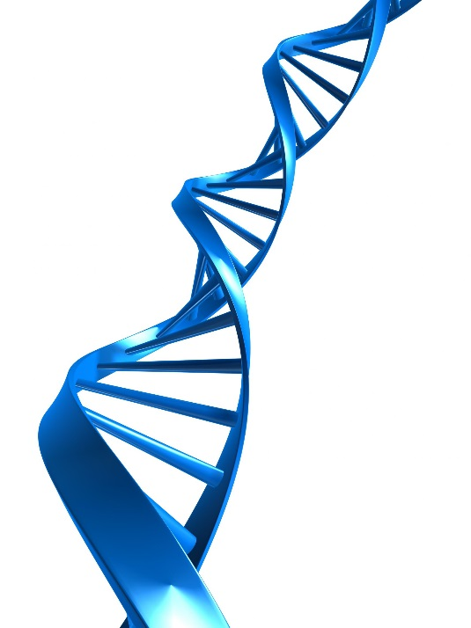
How do you classify cancer?
Surgical disease
Histopathological
Medical disease
Molecular
Classify by tissue of origin and histology
Classify by genetics
Lung cancer
Breast cancer
Colon cancer
Pancreatic cancer
Lymphoma
ACTGCGGGCTGACTGGACATCG
GCGGGCTGACGCGGGCTGACAT
CATTAGGACTACATAAACTTAGG
GGCTGACGCGGGCTGACATCAT
TGGCATTGAGCCCGAGCCATTG
CATTAGGACTACATAAACTTAGG
GGCTGACGCGGGCTGACATCAT
CATTAGGACTACATAAACTTAGG
GGCTGACGCGGGCTGACATCAT
TGGCATTGAGCCCGAGCCATTG
CATTAGGACTACATAAACTTAGG
GGCTGACGCGGGCTGACATCAT

Slide 5
Precision medical oncology
Oncogene addiction and mutational load
Wisconsin PMMTB
Opportunities

Slide 6
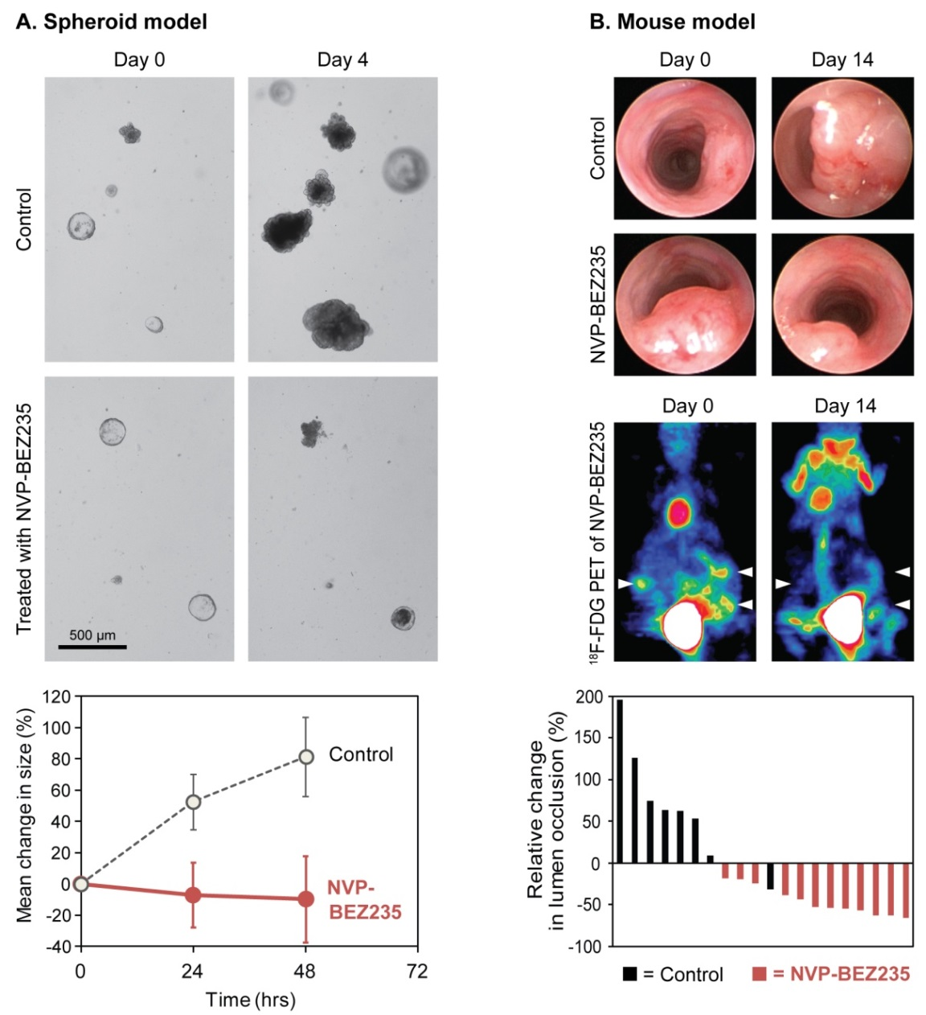
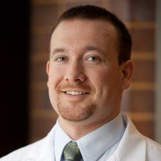
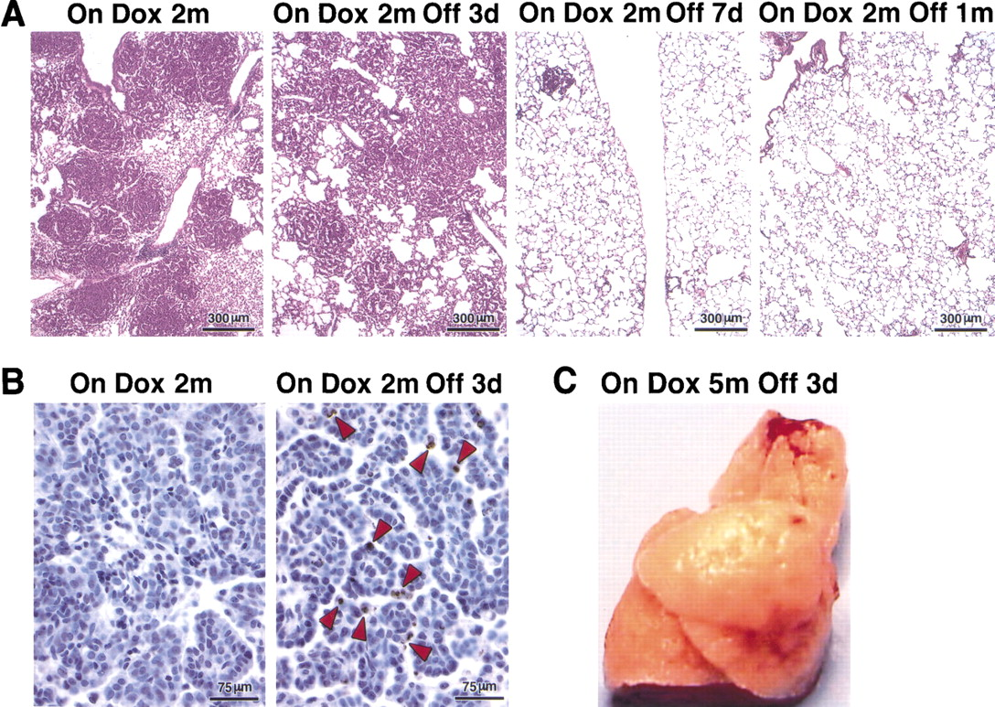
Oncogene addiction: preclinical evidence
PIK3CA model of CRC
KRAS model of lung cancer
Dusty Deming
Galen H. Fisher et al. Genes Dev. 2001;15:3249-3262

Slide 7
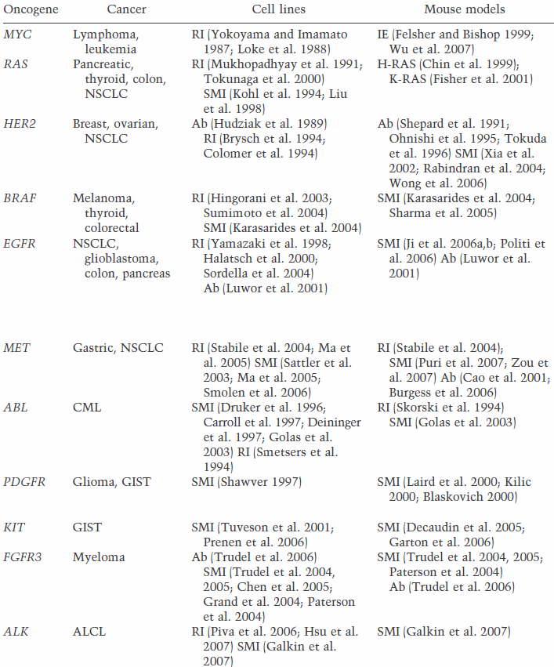
Sharma and Settleman. Genes and Development 21:3214, 2007

Slide 8
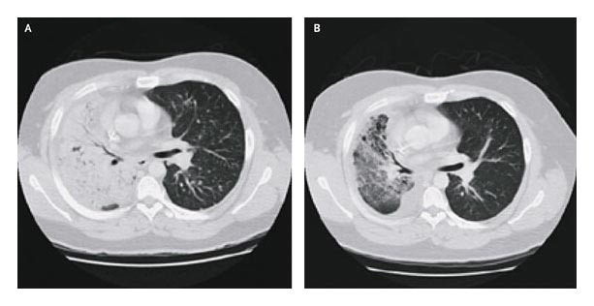
Oncogene addiction: clinical evidence
Pre-vemurafenib
Post-vemurafenib
(15 wk)
EGFR inhibitor in mutant lung cancer
Wagle et al. JCO 29:3085, 2011

Slide 9
Oncogene addiction is a general theme that can guide therapy.
Can DNA sequencing help select other drugs?

Slide 10
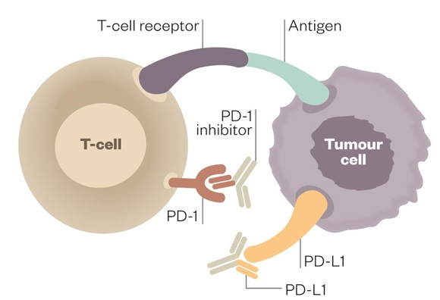
Immune checkpoint therapy

Slide 11
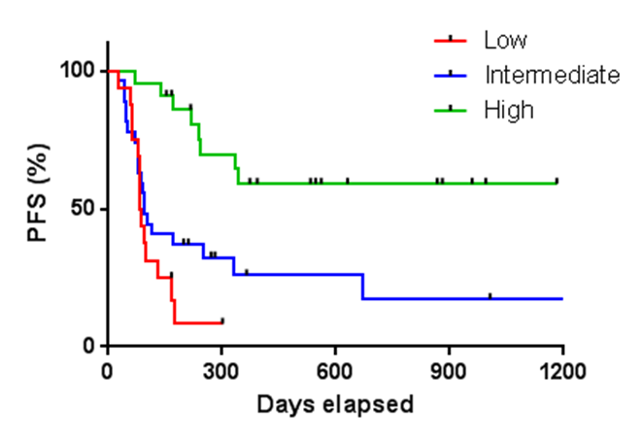
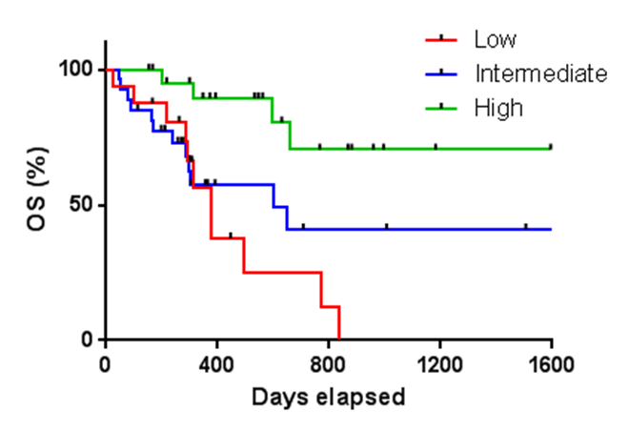
Mutational load predicts which melanoma, patients respond to anti-PD-1/PD-L1 (n=65)
Progression-free survival Overall Survival
PFS superior in high compared to intermediate and low groups (median not reached vs. 96 days vs. 85 days, p<0.001)
OS (median not reached vs. 600 days vs. 375 days, p=0.003).
Similar data in NSCLC & Bladder cancer

Slide 12
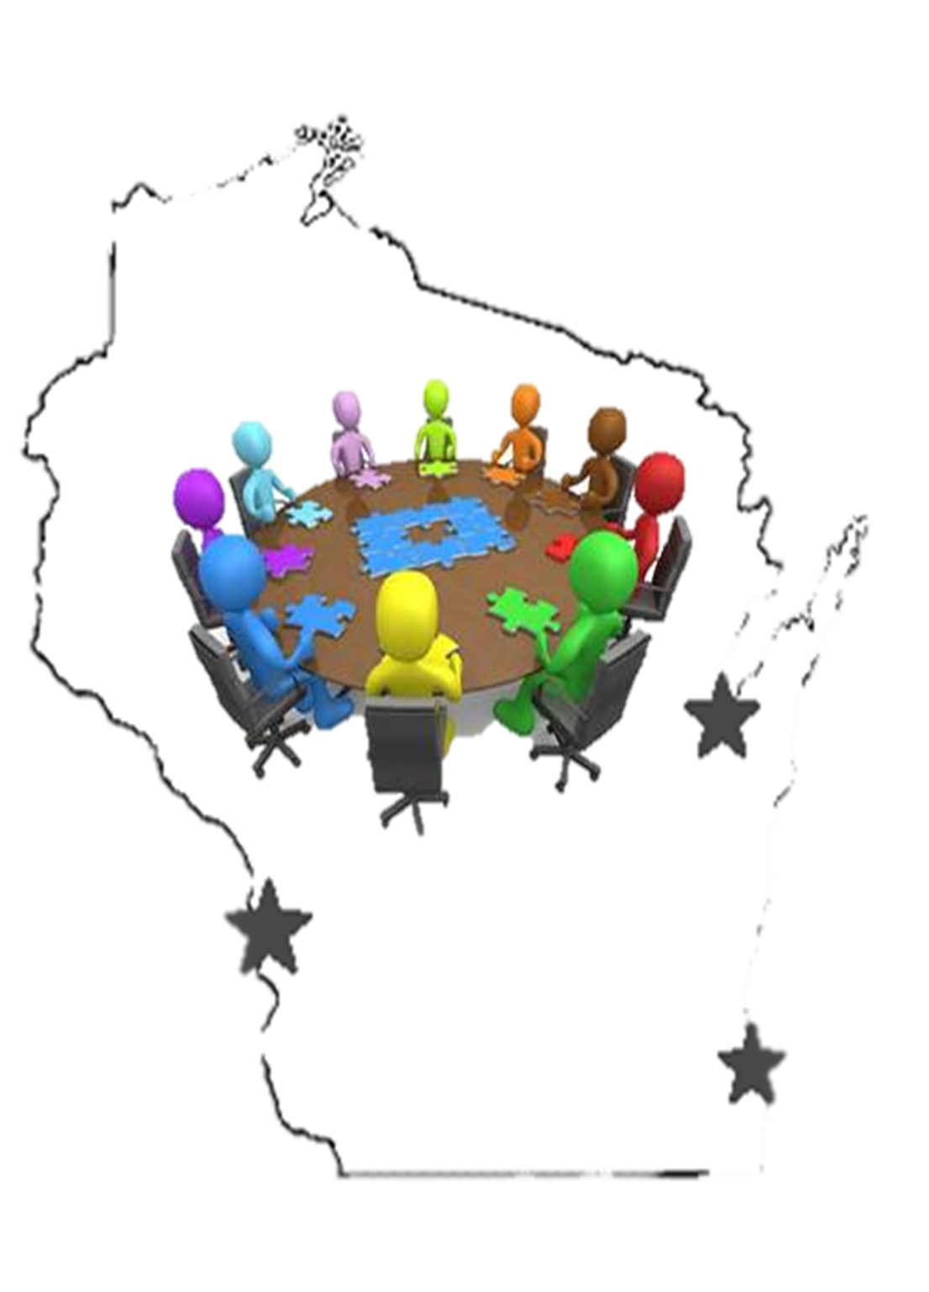
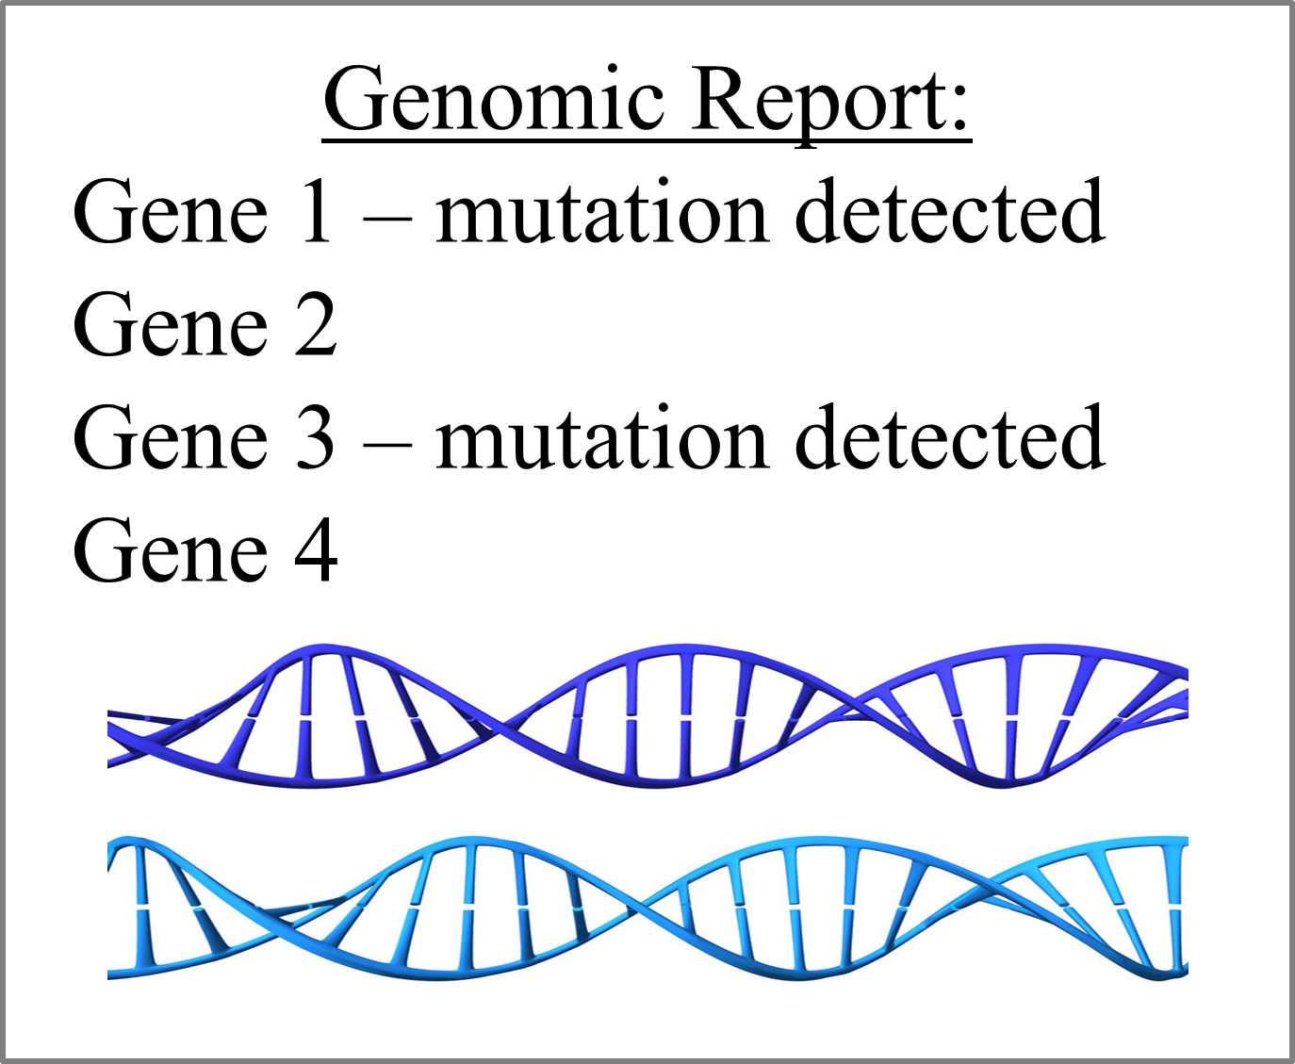
Wisconsin PMMTB
Coordinator: Marissa Schuh
mtb@uwcarbone.wisc.edu

Slide 13
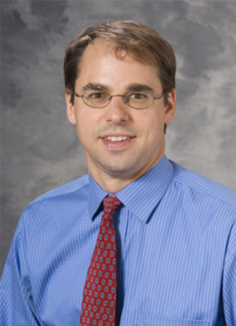
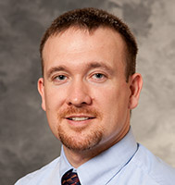
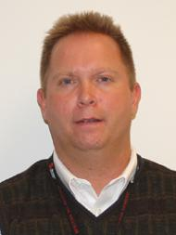
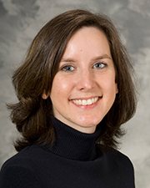
PMMTB Chairs
Med Onc Leaders:
Mark Burkard, MD, PhD
Dustin Deming, MD
UW Collaborative Genomics Core Leaders
Bill Rehrauer, PhD
Jennifer Laffin, PhD
UW Carbone Cancer Center
Joshua Lang, MD
Natalya Uboha MD PhD
Ticiana Leal, MD
Natalie Callander, MD
Pathology from UW Department of Pathology & Laboratory Medicine
Kristina Matkowskyj, MD, PhD
Darya Buehler, MD

Slide 14
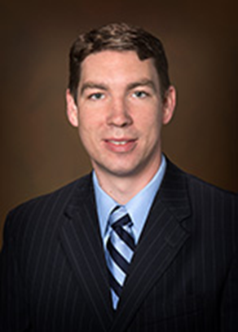
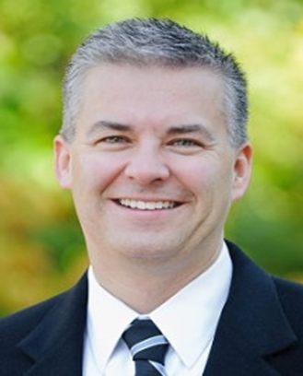
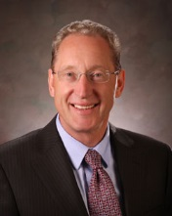
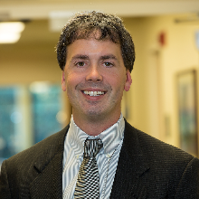
PMMTB Collaborators
Gundersen Lutheran – LaCrosse, WI
Benjamin Parsons, DO
Green Bay Oncology – Green Bay, WI
Ruth Warren, DO
Aurora – Southeast Wisconsin
Michael Thompson, MD, PhD
ThedaCare Cancer Care
Matthias Weiss, MD, PhD
Fox Valley Hematology & Oncology
Timothy Goggins, MD

Slide 15
Tripartite structure
Clinical service
Guidance
Research registry
Evidence review

Slide 16
Precision Medicine Molecular Tumor Board (PMMTB) Meetings
Meetings occur every 1st and 3rd Thursdays of each month at 4:30 pm CT
First meeting occurred on September 17th, 2015
30 meetings thus far
121 patient cases presented
Approximately 20 attendees from throughout the state*
*Including those attending in-person & via teleconference

Slide 17
PMMTB Journal Club
Establish a drug-biomarker pair
Amends the PMMTB guidance document
Monthly by web-conference 1 hour prior to PMMTB
8 meetings thus far
7 amendments made to the guidance document
Submitting a drug-biomarker nomination to the Journal Club:
Must be a participating PMMTB member
Submit 3 published papers 1 week ahead of the scheduled Journal Club
One of the papers must include clinical data on human subjects treated with the relevant drug.

Slide 18
UW15068: UWCCC Precision Medicine Molecular Tumor Board Registry
Objectives:
To determine the frequency of acceptance of PMMTB clinical recommendations.
To evaluate effectiveness of precision targeted therapies.
To create a bank of genomic data matched to clinical data
Enrolled 79 subjects as of January 25th, 2017
Eligibility criteria:
> 18 years with solid or hematological malignancy who will undergo genetic testing
Patient Involvement:
One time blood draw
Access to archived tissue
Fresh tissue sample if SOC biopsy is planned

Slide 19
PMMTB Recommendations
Recommendations:
Clinical Trials
Off-label treatment
*Note: more than one option is recommended per patient

Slide 20
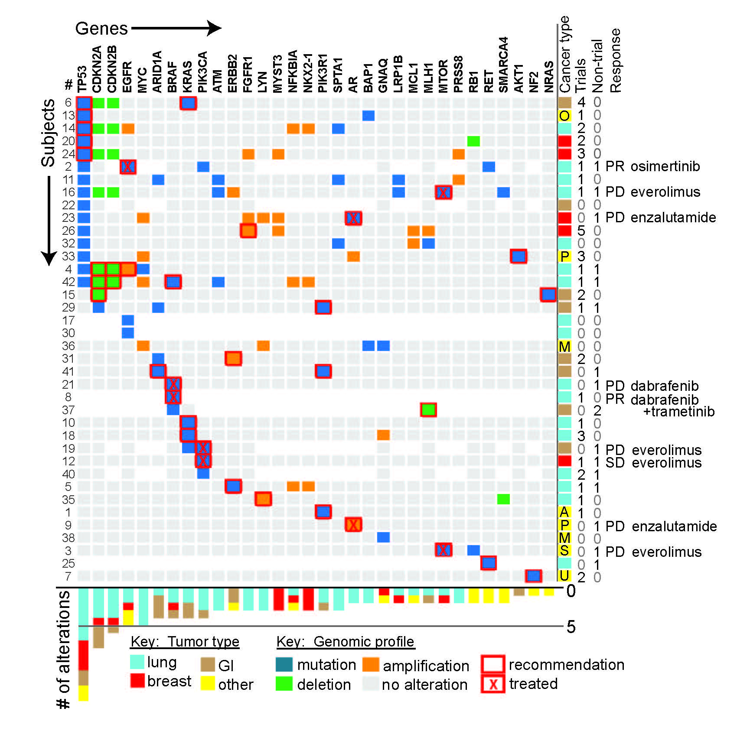

Slide 21
Opportunities
Enhance collaborations inside and beyond Wisconsin
Spheroids to prospectively assess tumor response

Slide 22
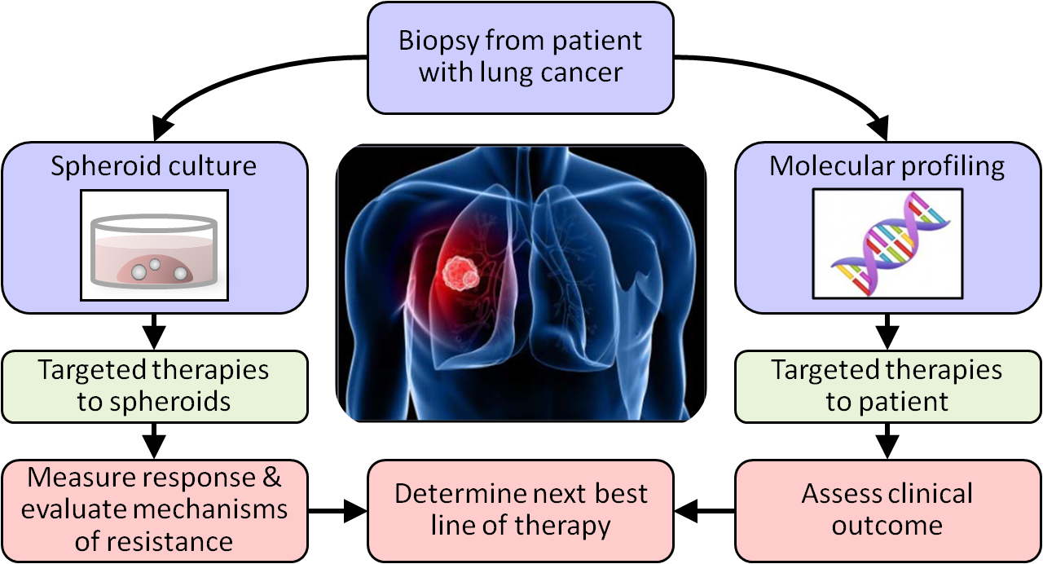
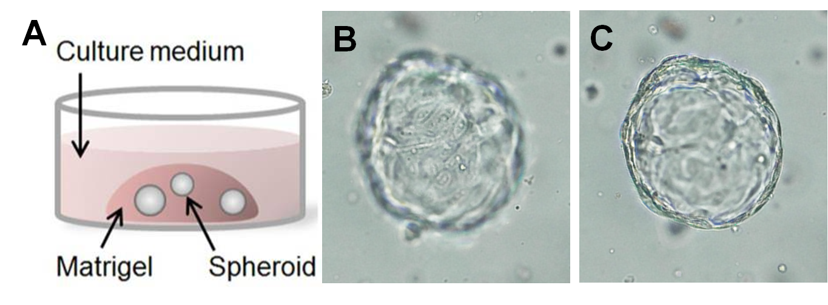
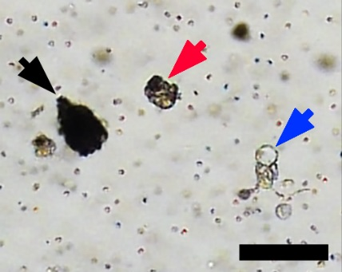
Patient-derived Spheroids as a Clinical Biomarker

Slide 23
Opportunities
Enhance collaborations inside and beyond Wisconsin
Spheroids to prospectively assess tumor response
Shared information for optimal patient care

Slide 24
Patient profile
Clinical response for matches
Matching patient profiles: PIK3CA, MYST3a
Breast Ca
PIK3CA mut
CDKN2a deletion
MYST3a mut
FGFR3 amp
Pt 1
Pt 2
D1 D2 D3 D4
Trial matches
Spheroid response for matches
Trial 1: BGJ398
Aurora, Gundersen
Matching patient profiles: PIK3CA, MYST3a
Trial 2: NCI-MATCH
Multiple sites
Pt 1
Pt 2

Slide 25
Opportunities
Enhance collaborations inside and beyond Wisconsin
Spheroids to prospectively assess tumor response
Shared information for optimal patient care
Clinical trials

Slide 26
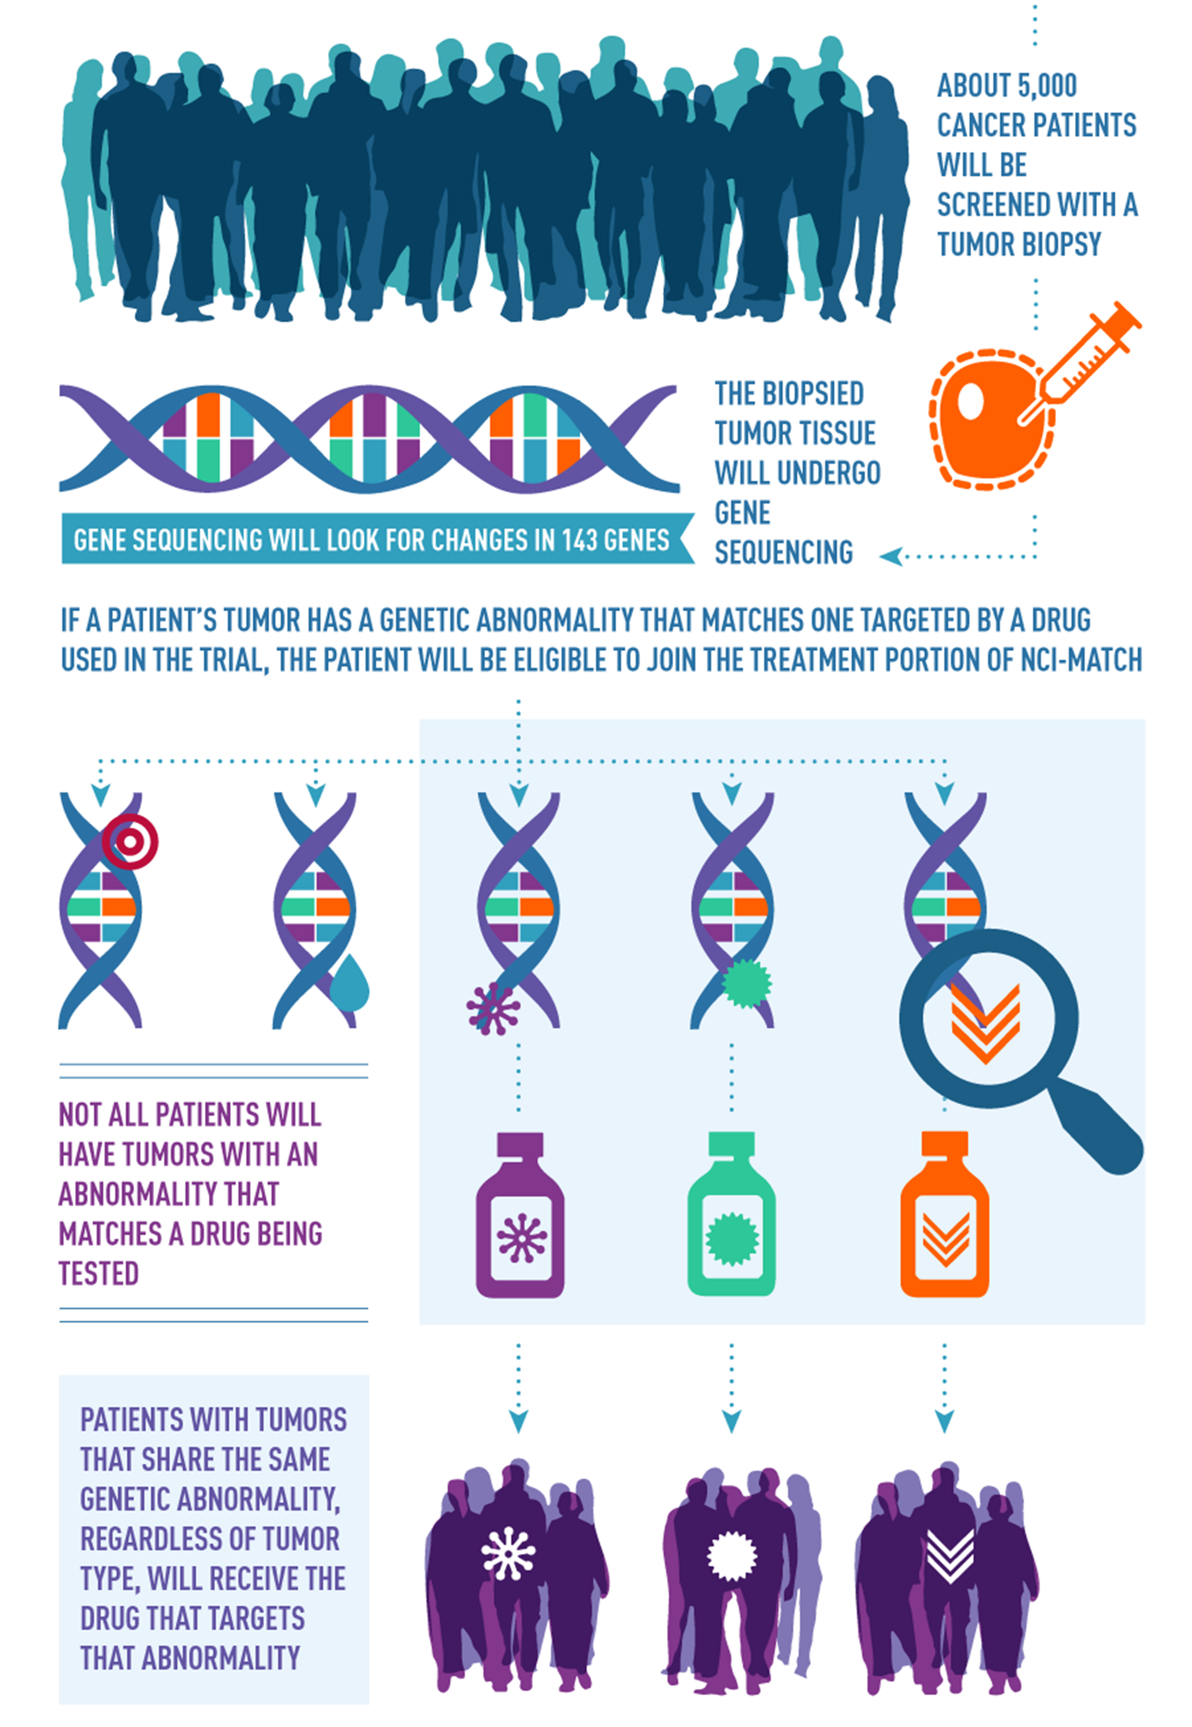
Basket Trial Design: NCI-MATCH
5000 patients to be screened
Targeted therapy in 24-30 arms
…10% match rate

Slide 27
Not barriers
Getting genomic tests done
(but dealing with
payers is trouble)
Off-label drugs

Slide 28
Early metamorphosis
Precision Oncology

Slide 29
Questions?

