Slide 1

WONIX: Training and
Scanner Harmonization
Tyler Bradshaw
WON Spring Meeting
April 9, 2016

Slide 2
WONIX objectives
Provide Wisconsin residents with access to advanced molecular imaging clinical trials
1. Increase availability of advanced molecular
imaging agents
2. Improve imaging standards
3. Establish an informatics highway for sharing data
4. Create a minable data warehouse
5. Implement state-of-the-art clinical studies

Slide 3
WONIX objectives
Provide Wisconsin residents with access to advanced molecular imaging clinical trials
1. Increase availability of advanced molecular
imaging agents
2. Improve imaging standards
3. Establish an informatics highway for sharing data
4. Create a minable data warehouse
5. Implement state-of-the-art clinical studies
My role

Slide 4
Quantitative PET imaging
Images are visual representations of numbers
2 3 4 5 5 4 3 2
1 4 5 7 7 6 5 2
2 5 7 9 9 8 5 2
2 5 8 9 9 8 5 2
2 5 7 9 8 6 3 2
2 3 5 6 5 4 2 1

Slide 5
Quantitative PET imaging
In PET, if we’re careful, numbers can be used for comparisons
Max = 9
Max = 15
Comparison within a patient

Slide 6
Quantitative PET imaging
In PET, if we’re careful, numbers can be used for comparisons
Max = 9
Max = 18
Comparison across patients

Slide 7
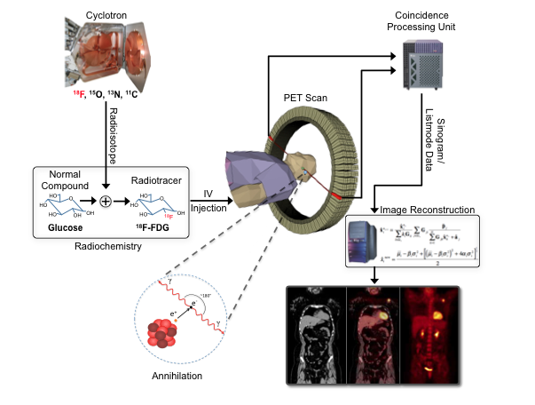
Problems in quantitative PET imaging
Uncertainties, uncertainties, uncertainties!
Image values affected by uncertainties at almost every stage of imaging
Example:
Errors up to 50%!

Slide 8
Reducing uncertainties
Harmonize, harmonize, harmonize!
Harmonize patient preparation
Harmonize injection methods
Harmonize scanning parameters
Harmonize image processing
Harmonize image analysis

Slide 9
Reducing uncertainties
Harmonize, harmonize, harmonize!
Harmonize patient preparation
Harmonize injection methods
Harmonize scanning parameters
Harmonize image processing
Harmonize image analysis
Site training

Slide 10
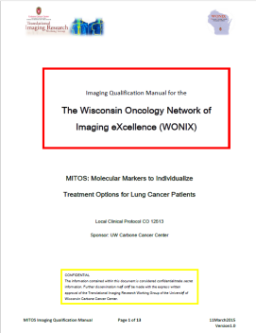
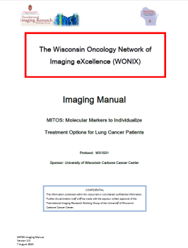
WONIX – site training
1. WONIX Qualification Site Initiation Visit
WONIX
Administrator
Imaging Manager
Imaging QA Manager
Imaging Program Specialist
Site
Site Administrator
Study Coordinator(s)
Imaging Facility Rep(s)
Qualification Manual
2. WON Clinical Site Initiation Visit
WONIX
Administrator
Imaging Manager
Imaging Program Specialist
Site
Site Administrator
Study Coordinator(s)
Imaging Facility Rep(s)
Imaging Manual

Slide 11
Reducing uncertainties
Harmonize, harmonize, harmonize!
Harmonize patient preparation
Harmonize injection methods
Harmonize scanning parameters
Harmonize image processing
Harmonize image analysis

Slide 12
Goals of qualification
Qualification Manual
Ensure that sites can acquire high quality images
Ensure scanner is properly calibrated and maintained
Harmonize WONIX site’s PET/CT scanner

Slide 13
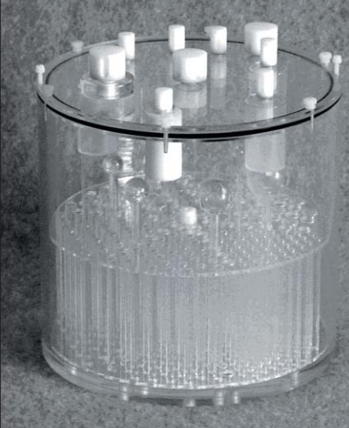
Phantoms for quality assurance
Phantoms = objects we can scan to simulate patients
We know what the image numbers should be
WONIX qualification phantom scanned at each site
WONIX evaluates the image quality, scanner calibration
Scanned at site
Evaluated by WONIX
Phantom
Phantom PET image

Slide 14
Goals of qualification
Qualification Manual
Ensure that sites can acquire high quality images
Ensure scanner is properly calibrated and maintained
Harmonize WONIX site’s PET/CT scanner

Slide 15
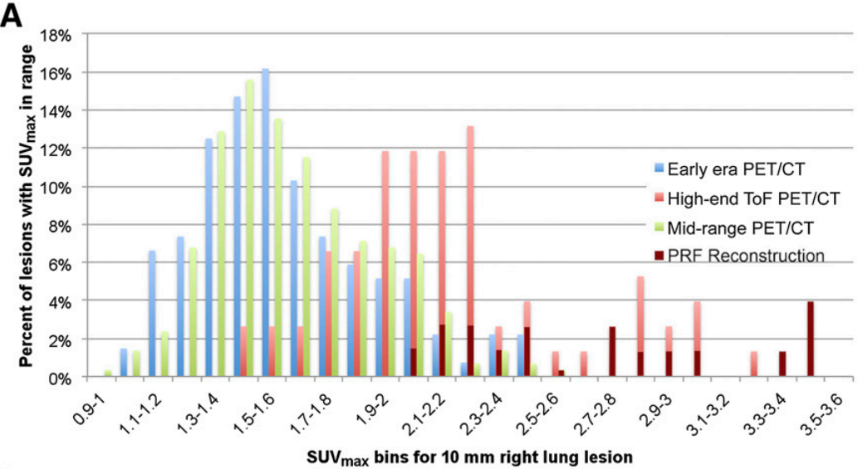
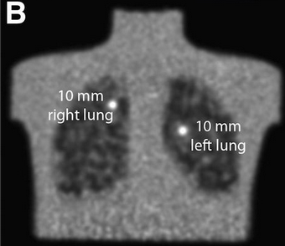
PET scanner harmonization
SNMMI’s Clinical Trials Network (CTN) sent the same phantom to 170 sites, and collected and analyzed the images.
SUV = PET image value

Slide 16
PET scanner harmonization
SNMMI’s Clinical Trials Network (CTN) sent the same phantom to 170 sites, and collected and analyzed the images.
Mid-range
High end TOF
Early era
PRF
LARGE DIFFERENCES BETWEEN SCANNERS!
SUV = PET image value

Slide 17
PET scanner harmonization
WONIX method for scanner harmonization:

Slide 18
PET scanner harmonization
Melanoma patient scanned 3 months apart on 2 scanners
Results
SUV differences: 22% → 6%
Noise differences: 24% → 0%

Slide 19
Impact of scanner harmonization
A lung cancer patient had multiple PET/CT exams on the Discovery VCT (DVCT) and Discovery 710 (D710) scanners. SUVmax was measured over time with (red) and without (blue) harmonization.

Slide 20
Harmonization workflow
Perform Qualification PET/CT scan
Performed by WONIX site
Performed by WONIX UWCCC
Reconstruct PET images
Submit PET/CT images and form to WONIX UWCCC
WONIX site uses recon parameters for all subsequent imaging
Send WONIX site PET/CT reconstruction request form
Compare image quality to reference scanner
Harmonized?
Send WONIX site the Harmonized Reconstruction Parameters
N
Y

Slide 21
Reducing uncertainties
Harmonize, harmonize, harmonize!
Harmonize patient preparation
Harmonize injection methods
Harmonize scanning parameters
Harmonize image processing
Harmonize image analysis
Check scanner calibration
Evaluate image quality
Scanner harmonization
Image QA checks

Slide 22
Reducing uncertainties
Harmonize, harmonize, harmonize!
Harmonize patient preparation
Harmonize injection methods
Harmonize scanning parameters
Harmonize image processing
Harmonize image analysis

Slide 23
WONIX image analysis workflow
WONIX QA and Analysis
WONIX site
Image quality assurance
Image analysis
Database

Slide 24
Quantitative PET imaging
In PET, if we’re careful, numbers can be used for comparisons
Max = 9
Max = 13
WONIX Site 1
WONIX Site 2
Goal: comparisons across SITES

Slide 25
Thank you!
WONIX Leadership
Robert Jeraj, Director
Scott Perlman, Co-Director
Dona Alberti, Administrator
WON
Ryan Mattison
Kari Wisinski
WON Representatives
WONIX Admin Support
Katie Kovacich
Mark McClintock
Angel Stampfli
Working Groups
Molecular Imaging Agents
Scott Perlman, Co-Chair
John Centanni, Co-Chair
Informatics
Richard Bruce, Co-Chair
Sean Fain, Co-Chair
Imaging Clinical Trials
Robert Jeraj, Co-Chair
Glenn Liu, Co-Chair
Quantitative Imaging
Chihwa Song, Co-Chair
Tyler Bradshaw, Co-Chair
Data
Jonathan Boott, Co-Chair
Umberto Tachinardi, Co-Chair

